Slide 1
Heroku
Cloud Application Platform

Slide 2
What is Heroku?
A multi-language cloud application platform built on Amazon EC2
Supported languages:
Ruby
Java
Clojure
Scala
Python
Node.js

Slide 3
History of Heroku
Developed since June, 2007
Salesforce.com completes acquisition of Heroku – January, 2011
Cedar Stack in public beta – May, 2011
Matz joins Heroku – July, 2011
Facebook and Heroku – September, 2011

Slide 4
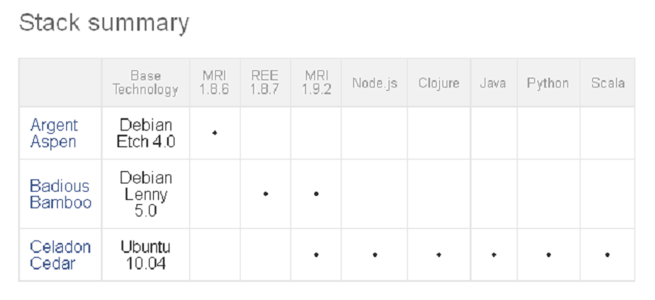
Stacks
Stacks are deployment environments including operating system, language runtime and libraries

Slide 5
Forget servers
Dynos:
Fully-isolated execution environments
Features:
Elasticity
Intelligent routing
Process management
Distribution and redundancy
Isolation

Slide 6
The Process Model
Process types:
Web processes
Workers
One-off admin processes
Processes are defined for each application in a special file called Procfile
Processes are executed on dynos

Slide 7
Easy deployment with Git
Init Git repository:
git init
Adding changes to the index:
git add .
Commit to local repo:
git commit –m ”commit message”
Create your application on Heroku:
heroku create myapp --stack cedar
Commit to Heroku’s remote repo:
git push heroku master

Slide 8
Control surfaces
Heroku toolbelt:
https://toolbelt.heroku.com/
Web console:
https://api.heroku.com/login
Heroku REST API:
https://api-docs.heroku.com/

Slide 9
Heroku for Java 1.
OpenJDK 6
Maven 3.0.3
Java applications do not run in any Java container at all
Any application server can be used, that can be embedded and defined with a Maven dependency (Jetty, Tomcat, Glassfish and Resin)
Embedded Tomcat (version 7.0.x) and embedded Jetty (version 7.4.x) have been tested with Heroku

Slide 10
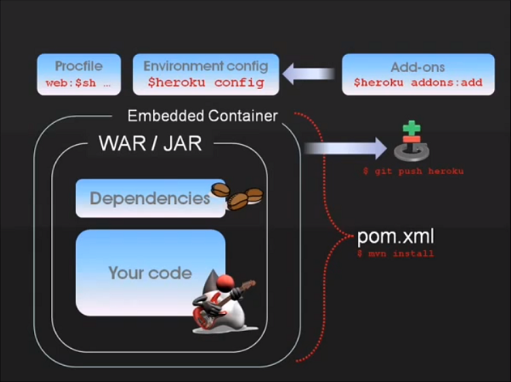
Heroku for Java 2.

Slide 11
Scaling with instant spin-up 1.
Easily and quickly with ‘heroku’ command line tool:
heroku scale web=6 worker=2
Nezumi:
http://nezumiapp.com/
Autoscaling is not addressed by Heroku
Implement your own autoscaling, or use third parties like:
http://hirefireapp.com/
http://www.heroscale.com/

Slide 12
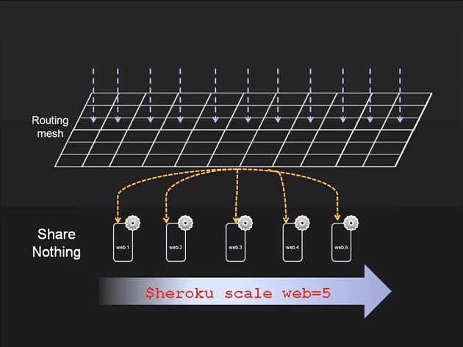
Scaling with instant spin-up 2.

Slide 13
Dyno prices
Dynos cost $0.05 per hour, prorated per second
Each application receives 750 free dyno hours per month
Apps that have only 1 web dyno will be idled out after 1 hour of inactivity
More info at http://www.heroku.com/pricing

Slide 14
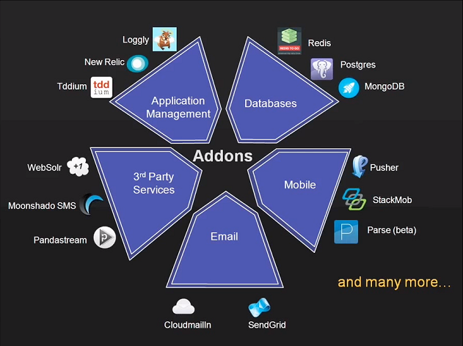
Add-ons

Slide 15
Competitors
Amazon Elastic Beanstalk (beta)
http://aws.amazon.com/elasticbeanstalk/
Cloud Foundry (beta)
http://www.cloudfoundry.com/
Google App Engine
http://code.google.com/appengine/
Microsoft Azure Services Platform
http://www.windowsazure.com/
Jelastic Java PaaS (beta)
http://jelastic.com/

Slide 16
Questions?

Slide 17
Thanks for Your Attention
Heroku Cloud Application Platform
By
Zoltan Gorbe
Software Developer
EPAM Systems
41 University Drive, Suite 202 | Newtown, PA 18940
p: +1 267 759 9000 | f: +1 +1 267 759 8989 | e: info@epam.com | w: www.epam.com

